Slide 1





MODELING IN PRACTICE: THE LIFE CYCLE OF A MODELING PROJECT, FROM CONCEPTION TO PUBLICATION - The example of Buruli ulcer in Cameroon -
Andrés Garchitorena
Researcher, Institut de Recherche pour le Développement
Associate Scientific Director, PIVOT Madagascar
E²M² Workshop, Ranomafana, March 2024

Slide 2
1
i
1
1
Steps in a modeling project
Development of the study concept and question
Literature review
Data collection
Construction of model framework
Model analyses and selection
Model validation
Manuscript writing and submission
Introduction

Slide 3
1
?
i
1
1
Development of the study concept
What is your question?
Why is it interesting?
Who is interested?
Can it be narrowed down to a question about specific quantitative relationships?
Introduction

Slide 4
1
ii
1
1
Literature review
Who has tried to answer this before and how did they do it?
Empirical studies
Modeling studies
What are these studies short-comings?
Are there already parameter estimates or data sets to help you answer your question?
Introduction

Slide 5
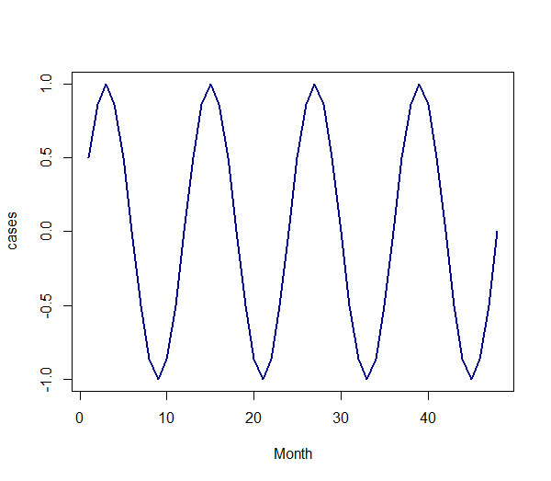
1
iii
1
1
Data collection
What do you need to characterize?
Spatial and/or temporal dynamics
Relationships between parameters or systems
Introduction

Slide 6
1
iv
1
1
Construction of model framework
What drawbacks of previous studies can I mitigate?
What type of modeling is necessary to answer my question?
Statistical: GLM, spatial, time-series, etc.
Mathematical: population based, individual based
What modeling elements are necessary for my question?
Stochasticity
Compartments and complexity
Introduction

Slide 7
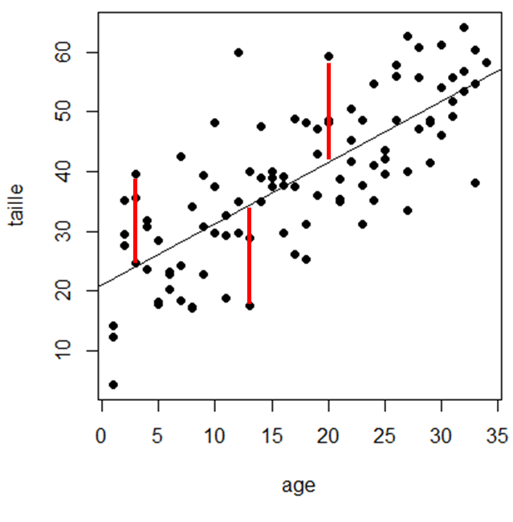
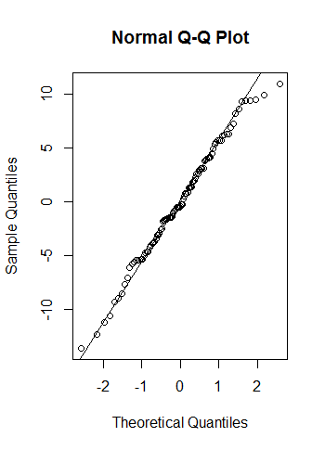
1
v
1
1
Model analysis, selection and validation
What model(s) best fit my data and explain my question?
Comparison of alternative models and application of selection procedures
Does the selected model suffer from any substantial drawbacks?
Statistical models: verification of model assumptions
Mathematical models: sensitivity analyses and out-of-sample predictions
Introduction

Slide 8
1
i
1
1
Types of modeling studies
Development of the study concept
Literature Review
Data collection
Construction of model framework
Dynamic equations and code
Relationships between parameters
Model analyses and selection
Parametrization
Simulations and debugging
Model validation
Model validation
Sensitivity analyses
Manuscript writing and submission
Without data collection
Purely theoretical studies
Parametrization based on published studies
Systematic reviews and meta-analyses
Experimental and field studies
Introduction

Slide 9
1
i
1
1
Types of modeling studies
Development of the study concept
Literature Review
Data collection
Construction of model framework
Statistical vs. Mathematical model
Model better adapted to our data
Model analyses and selection
Descriptive, univariate and multivariate
Parametrization and simulations
Model validation
Model validation, comparison
Sensitivity analyses
Manuscript writing and submission
With data collection
Data already collected for other purposes
Focus only on analyses
Need to understand data limitations and quality
Need to adapt modeling to the available data
Data collected for the modeling project
Very time consuming
Modeling is generally more straightforward
Introduction

Slide 10

The example of Buruli ulcer
in cameroon

Slide 11
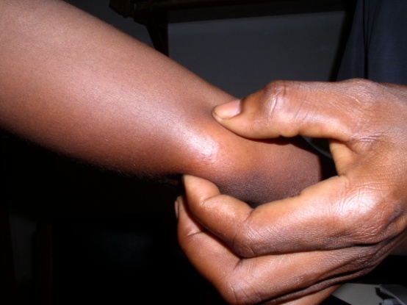
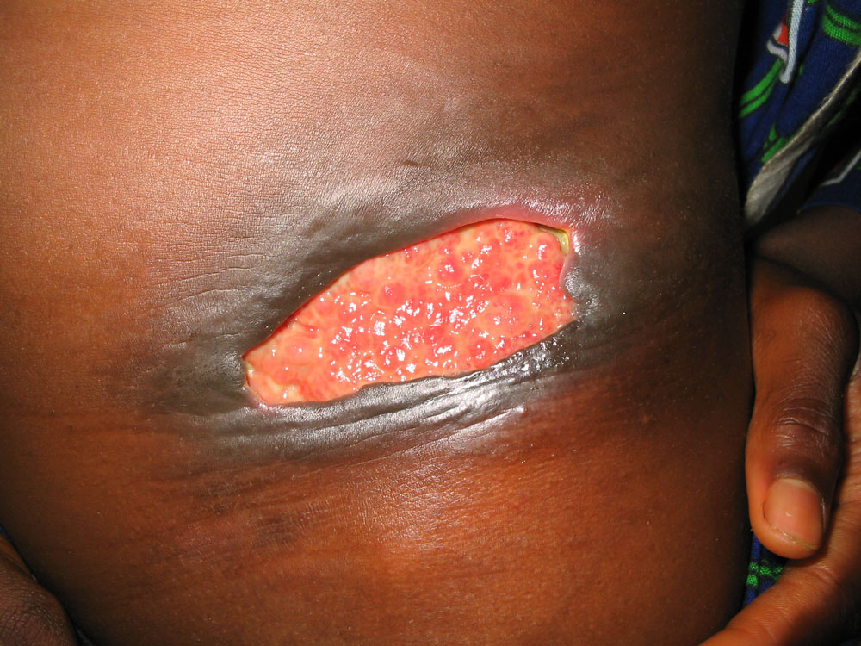
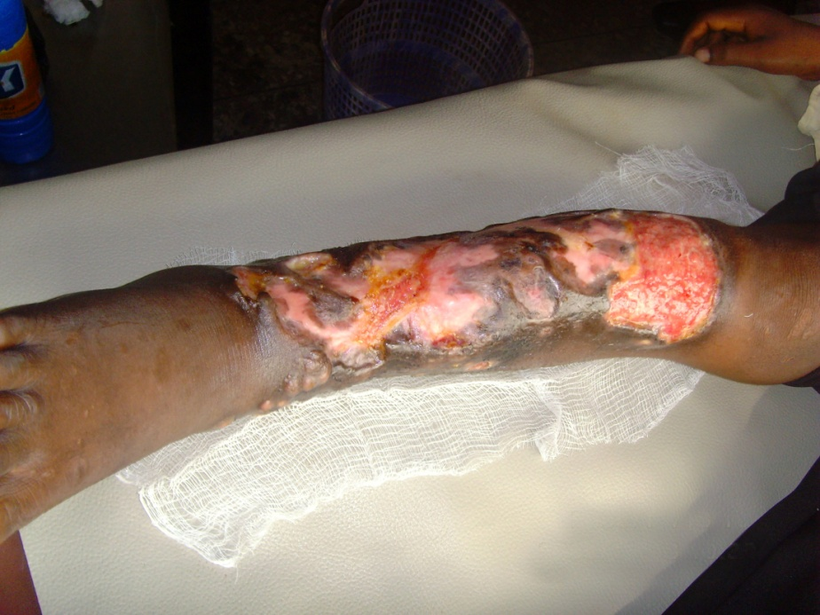
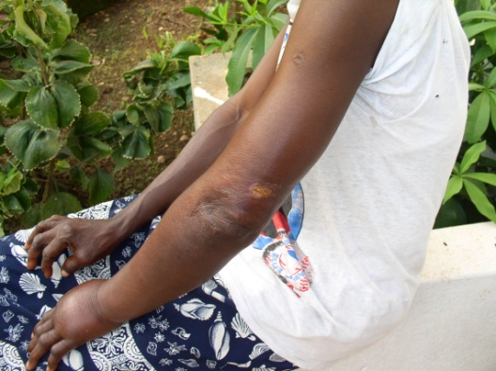
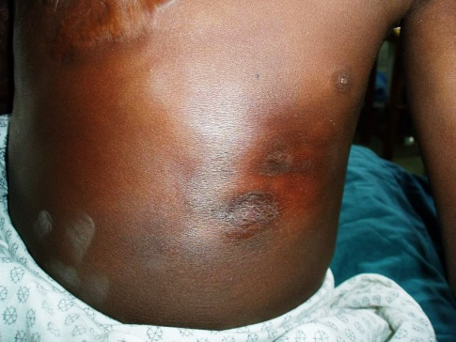
1
i
1
1
Buruli ulcer
Most affected : Children <15 years
25% cases with functional limitations
Source of images: www.who.int (2014)
Introduction

Slide 12
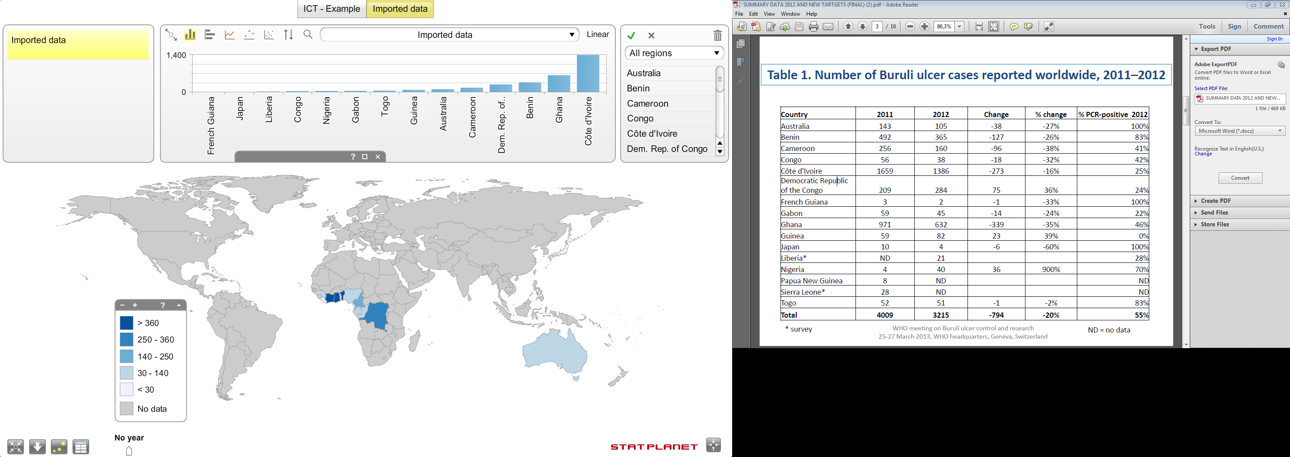
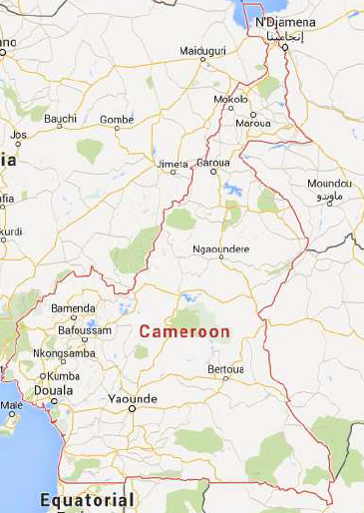
1
i
1
1
Buruli ulcer: an emergent and neglected disease
BU cases 2012
WHO meeting on BU control and research (2013)
Landier et al. (2014, PLoS NTDs)
Around 5000 new cases each year
Cases in more than 30 countries
Focal distribution
Introduction

Slide 13
What is my question?
Why is it interesting?
Who has tried to answer this before and how?
What are these studies short-comings?
1. LITERATURE REVIEW
&
IDENTIFICATION OF THE PROBLEM

Slide 14
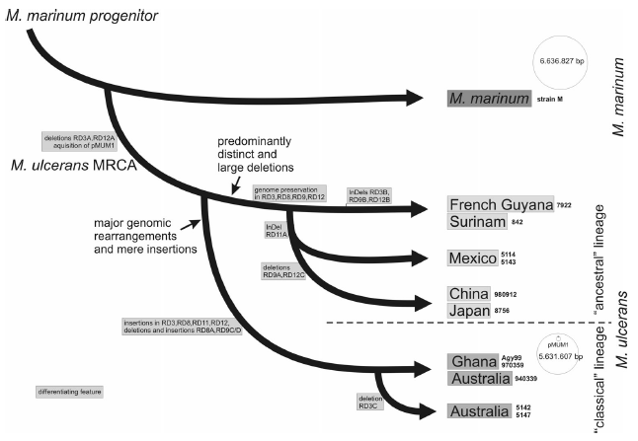






1
ii
1
Mycobacterium ulcerans: generalities
Multi-host
&
Environmentally persistent
Kaser et al. (2007, BMC Evolutionary Biology)
Introduction
Introduction

Slide 15
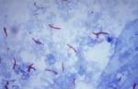
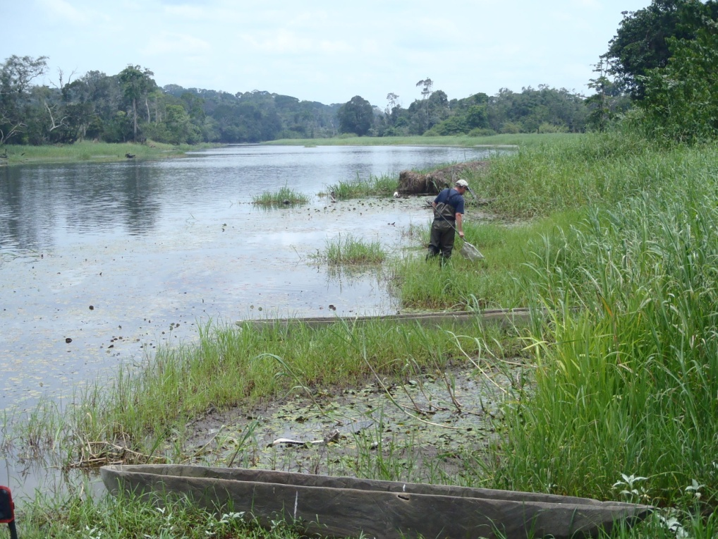
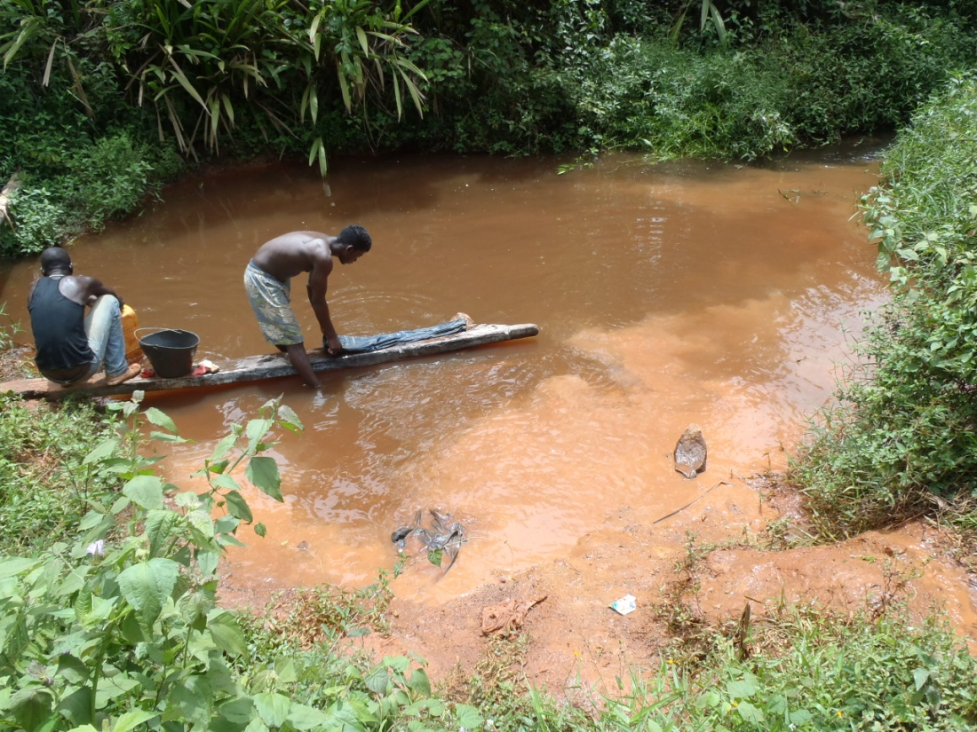
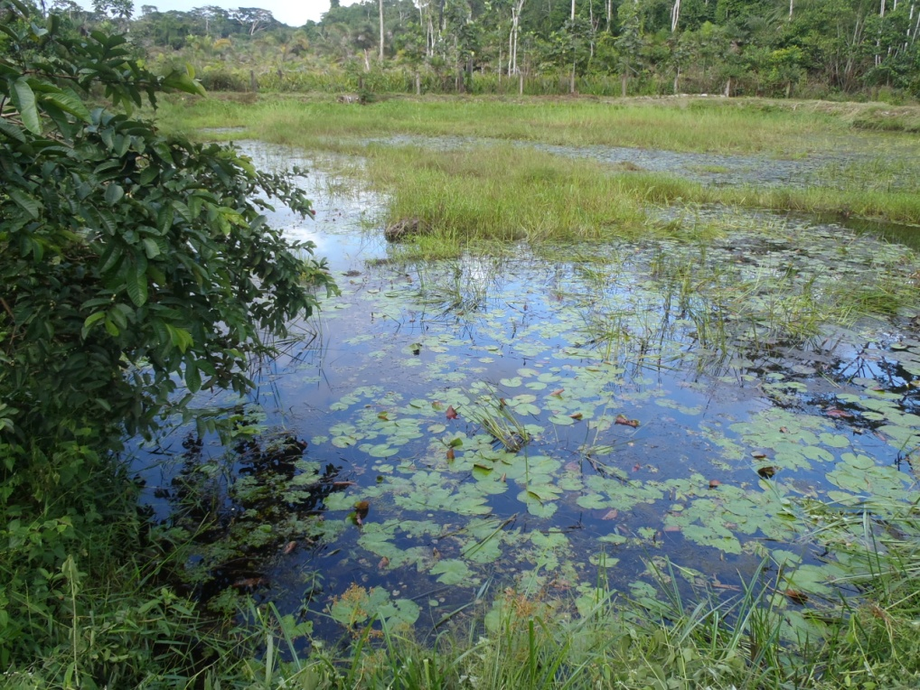
1
ii
1
Buruli ulcer: a disease linked to aquatic ecosystems
BU Risk factors
Proximity to stagnant or slow flowing waters
Activities near water
M. ulcerans
Introduction

Slide 16
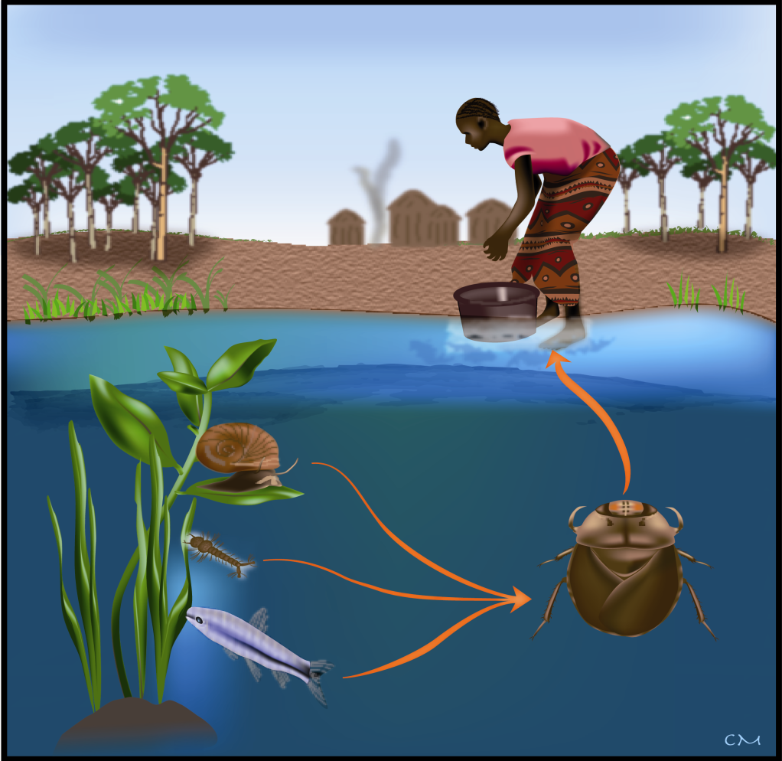
ii
1
Buruli ulcer: a mysterious disease
?
Hypothesis 1
Direct transmission from the environment
Hypothesis 2
Aquatic biting bugs as vectors
Source: L. Marsollier
Introduction
Introduction

Slide 17
iii
1
Objectives of the project
General objective
To gain insights on the ecological determinants of Buruli ulcer disease.
2
M. ulcerans dynamics
Buruli ulcer
in humans
1
Environmental factors
Specific objectives
1
To understand the effects of environmental factors on M.ulcerans ecology
2
To study the transmission of M.ulcerans from the aquatic environment to humans
Introduction

Slide 18
What do I need to characterize?
Spatial and/or temporal dynamics?
Relationships between parameters or systems?
DATA COLLECTION
& DESCRIPTIVE ANALYSES

Slide 19
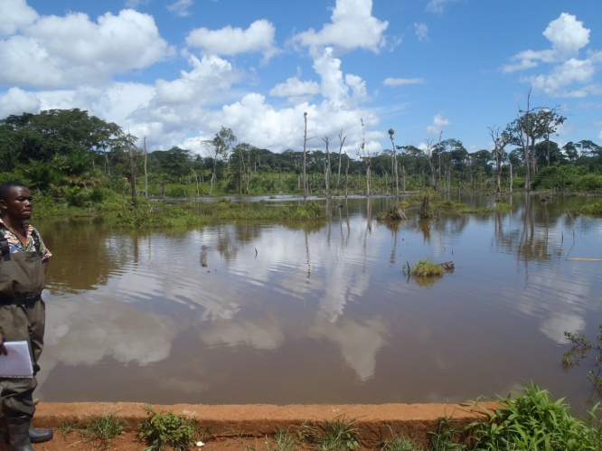
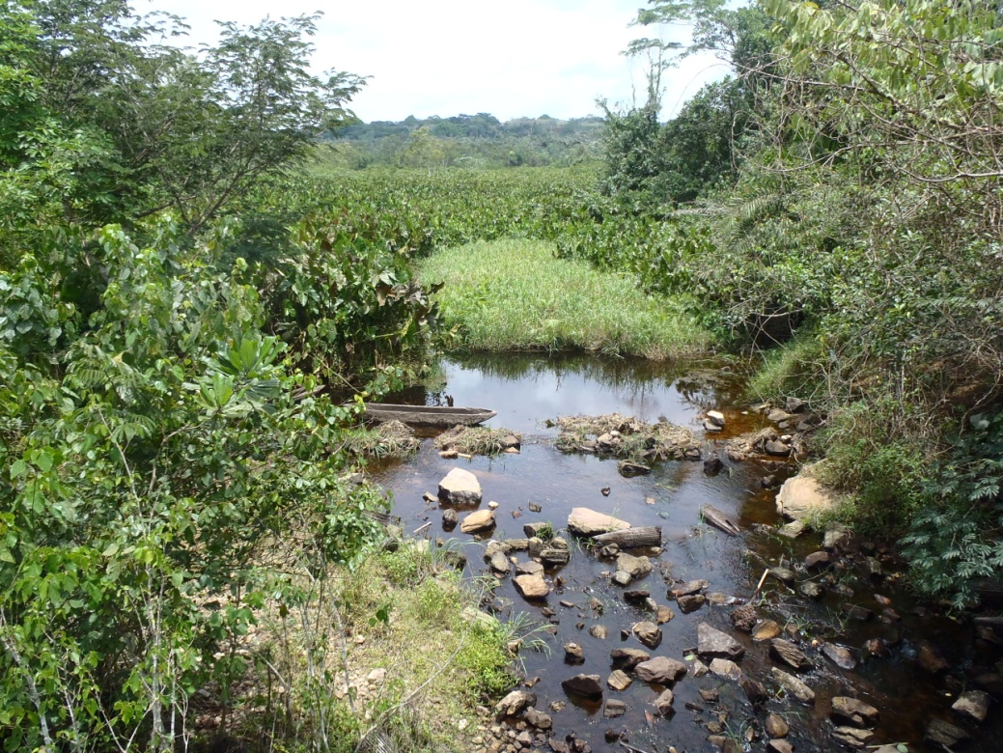
1
Introduction
Favourable environments
Unfavourable environments
Characterization of MU in the environment

Slide 20
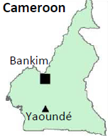
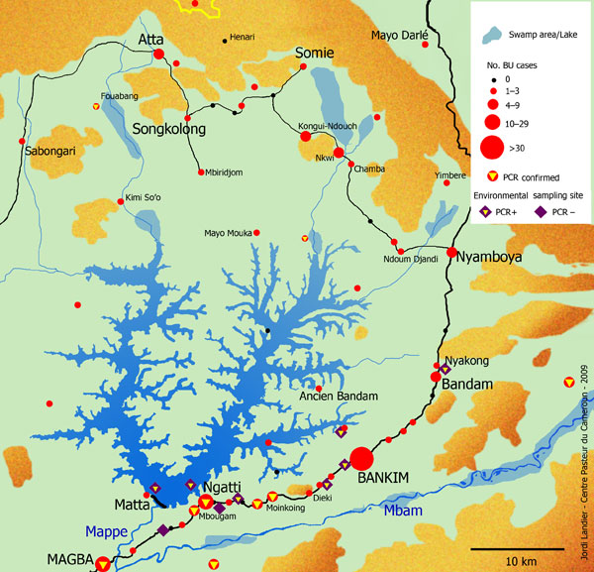
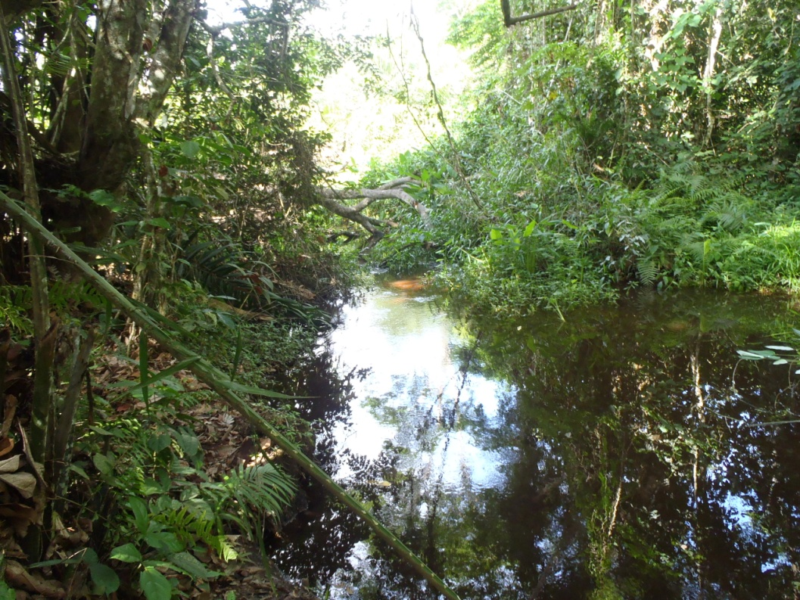
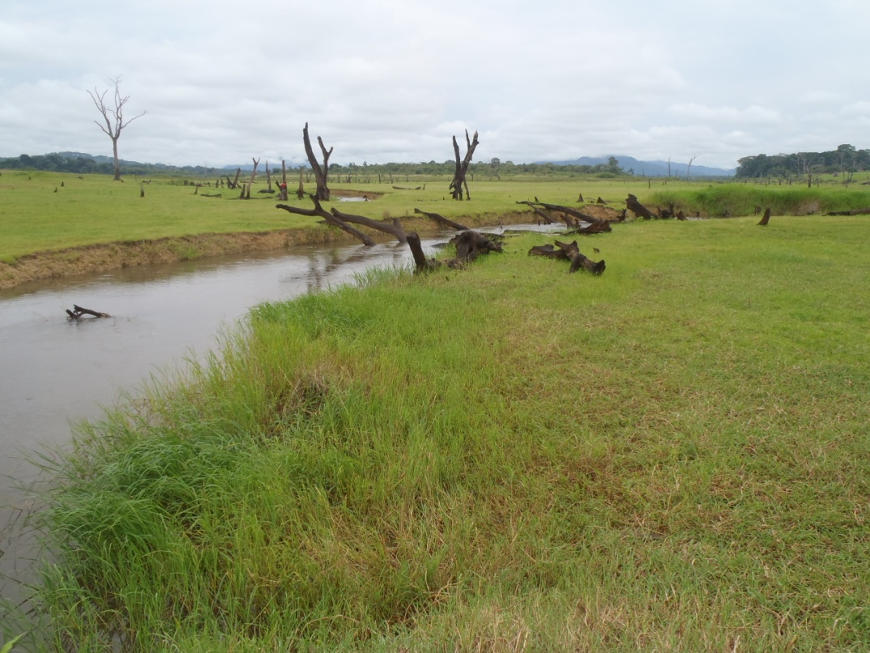
1
Regions of study
Akonolinga
Bankim
Landscape: Tropical rainforest
Historically endemic area (>40 years)
Landscape: Savannah-Forest
New endemic area (10 years)
Akonolinga
Marion et al. (2011, EID)
Landier et al. (2014, PLoS NTDs)
Characterization of MU in the environment

Slide 21
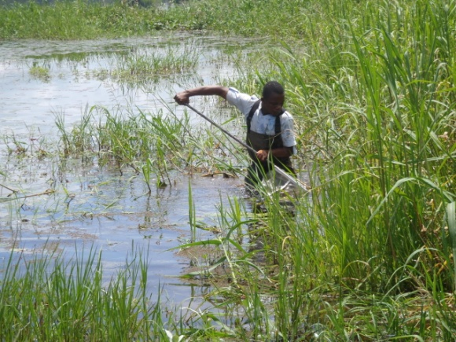
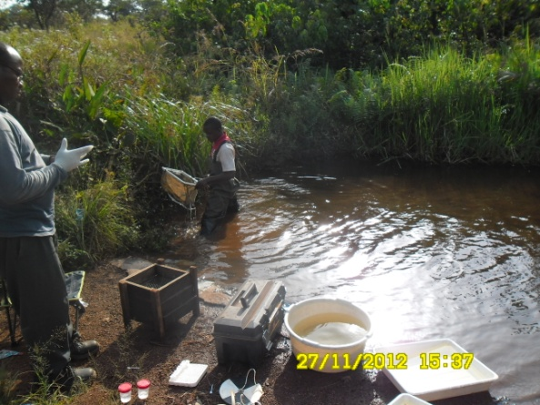
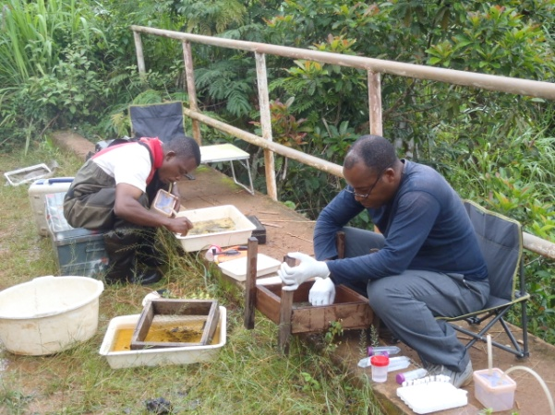
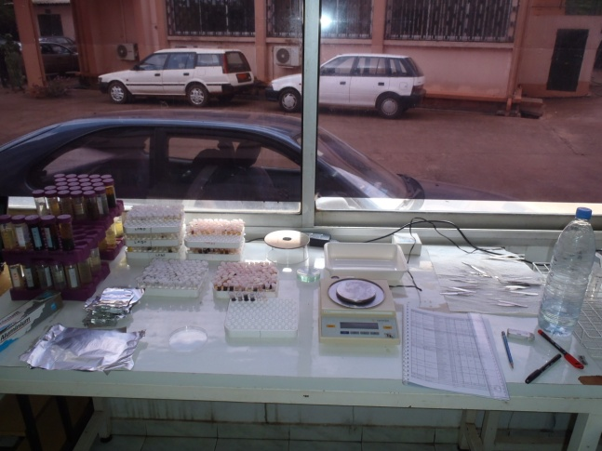
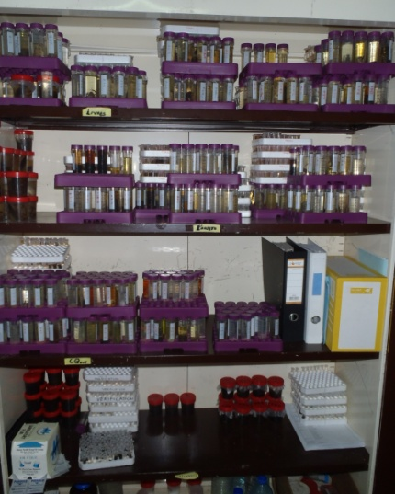
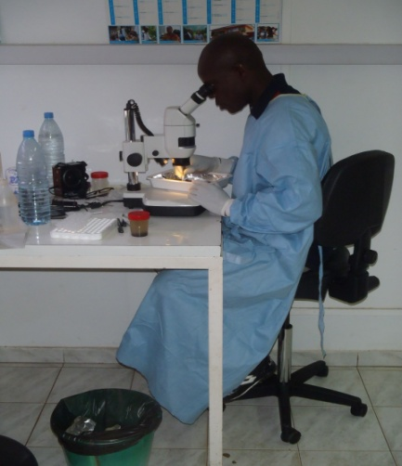
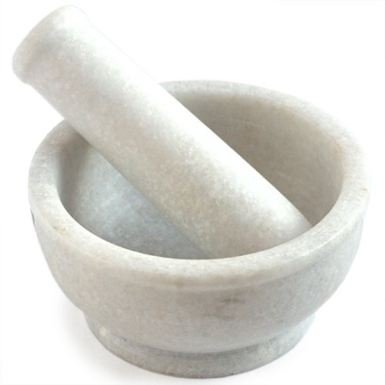
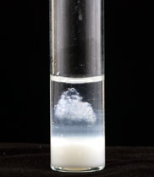
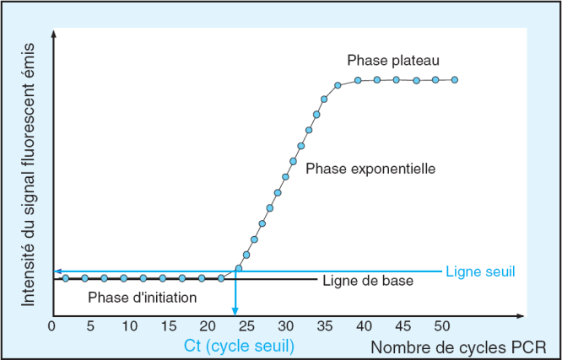
1. Fieldwork: Environmental sampling
2. Laboratory (CPC): Taxonomic identification & Pool composition
3. Laboratory (Angers): DNA extraction & Amplification
KR & IS2404
Characterization of MU in the environment

Slide 22
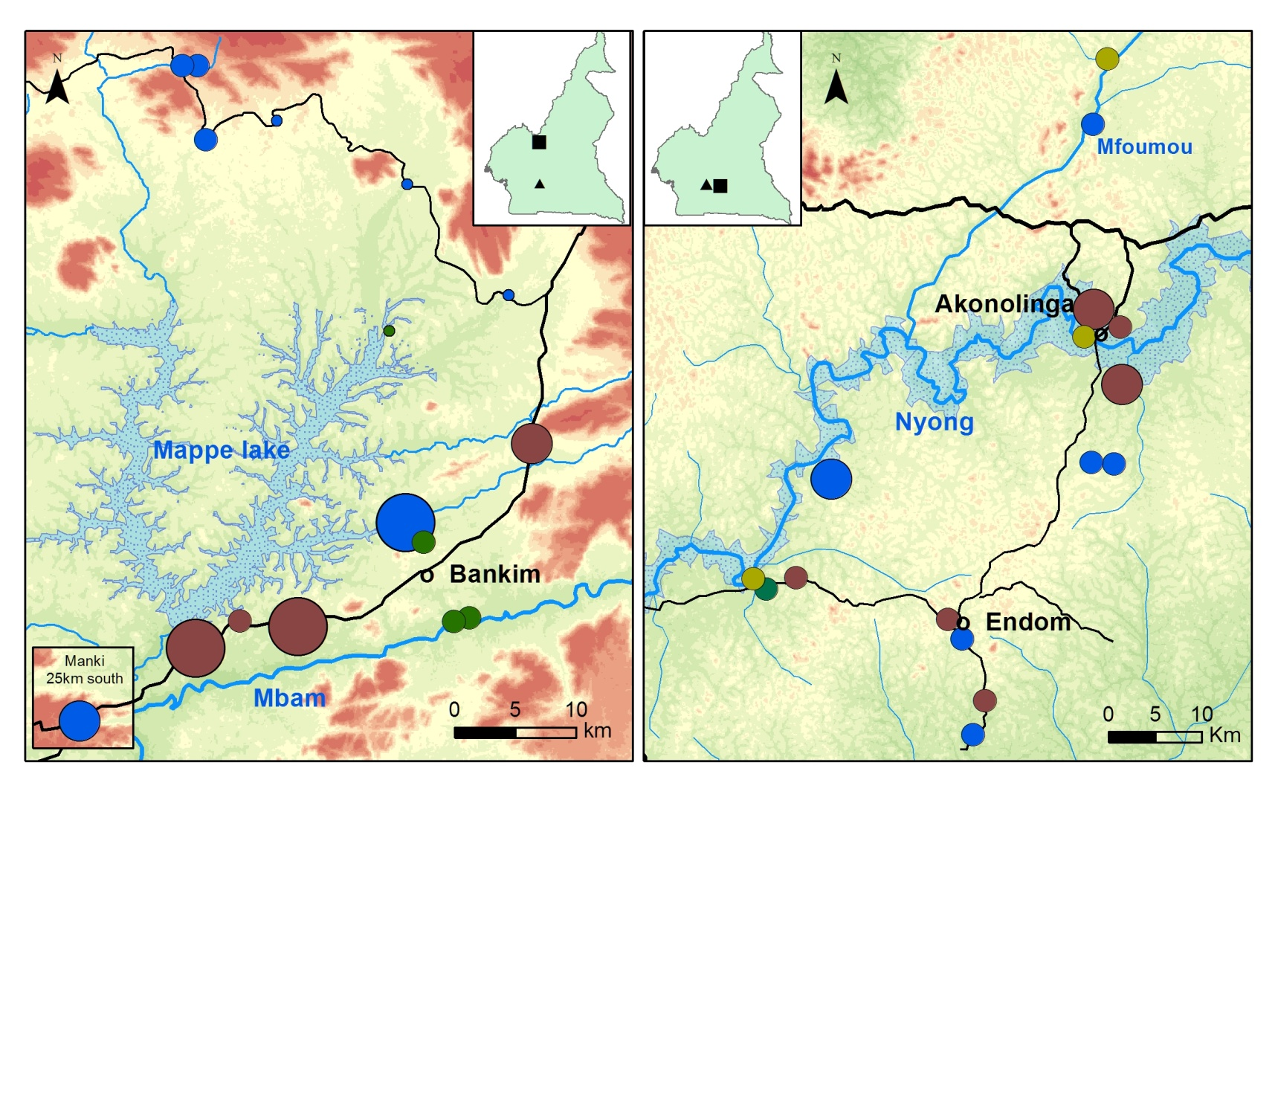
3
1
M. ulcerans geographical distribution
Cameroon
Cameroon
Bankim
Akonolinga
Yaoundé
Yaoundé
Type of ecosystem sampled
Percentage of Positive Pools
Elevation (m)
Basin
Stream
0
< 300
.
.
.
.
.
1-10
.
.
Flooded Area
10-20
700
Swamp
River
>20
> 1000
Garchitorena et al. (2014, PloS NTDs)
Characterization of MU in the environment

Slide 23
1
Seasonal fluctuations of M. ulcerans in freshwater ecosystems
2012
2013
Garchitorena et al. (2014, PloS NTDs)
Characterization of MU in the environment

Slide 24
What type of modeling is necessary to answer my question?
M. ulcerans dynamics
Buruli ulcer
in humans
1
Environmental factors
Environmental factors
statistical analyses to understand m. ULCERANS ECOLOGY

Slide 25
2
3
Environmental drivers of M. ulcerans
Biotic Factors
Abundance of species
Community assemblages
Trophic interactions
Others
Seasonal Climatic Factors
M. ulcerans
positivity
Temperature
Rainfall
Others
Water Characteristics
Temperature
Oxygen
pH
Conductivity
Others
Environmental drivers of MU

Slide 26
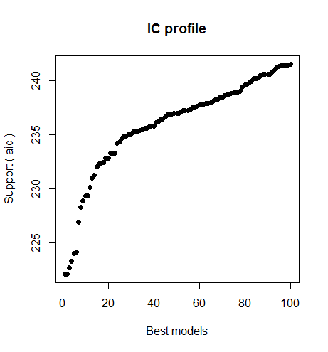
2
3
Methodology: Multi-model approach
Model Definition
Generalized linear mixed model (binomial)
Random effect: Sample site
Fixed Effects
Response
Variable
Biotic Factors
Multi-model Selection
Screening of possible combinations in a given set
Selection of the best models (AIC)
Seasonal Factors
M. Ulcerans
positivity
Model-averaged estimates
Importance of terms
Unconditional SE, lower and upper CI
Multi-model Inference
Water
Characteristics
Environmental drivers of MU

Slide 27
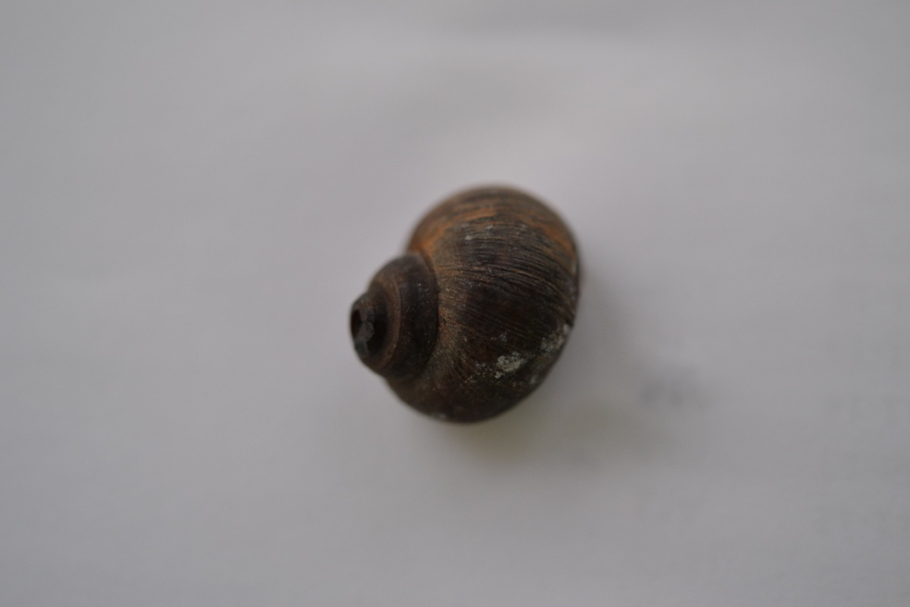
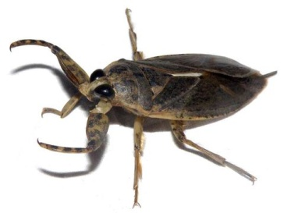
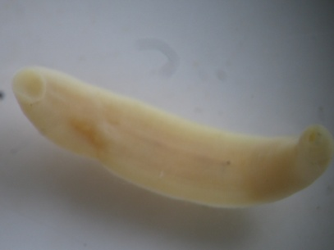
2
Environmental drivers of M. ulcerans: Akonolinga
Biotic
Factors
Variable | Avg.beta | Lower.CL | Upper.CL | Relative Importance
(Intercept) | -13,66 | -22,50 | -4,82 | 1
SEASONALITY
Sin(2pi*Mois/12) | 0,35 | 0,02 | 0,69 | 1
Sin(2pi*Mois/4)
Cos(2pi*Mois/12)
Cos(2pi*Mois/4)
Seasonal Factors
M. Ulcerans
positivity
Water
Characteristics
PHYSICOCHEMICAL PARAMETERS
pH | 8,20 | 3,25 | 13,14 | 1
Flow
Temperature
Dissolved Oxigen
Conductivity
AQUATIC COMMUNITY
Abundance | -0,70 | -1,06 | -0,34 | 1
Biodiversity
AQUATIC TAXA (%)
Gastropoda | -22,27 | -36,86 | -7,68 | 1
Hemiptera | -7,33 | -13,42 | -1,23 | 0,92
Hirudinea | 0,57 | 0,06 | 1,08 | 0,87
Diptera | 1,84 | -1,27 | 4,94 | 0,81
Hydracarina | 18,07 | -2,07 | 38,22 | 0,77
Oligochaeta | 0,27 | -0,28 | 0,82 | 0,76
Tricoptera | 1,29 | -5,20 | 7,78 | 0,73
Coleoptera | 3,13 | -0,31 | 6,57 | 0,49
Odonata | 1,35 | -1,92 | 4,62 | 0,44
Anura | -3,83 | -9,11 | 1,45 | 0,26
Ephemeroptera | 3,08 | 0,22 | 5,93 | 0,26
Decapoda | -1,01 | -1,81 | -0,21 | 0,21
Environmental drivers of MU

Slide 28
2
3
Environmental drivers of M. ulcerans: Bankim
Biotic
Factors
Variable | Avg.beta | Lower.CL | Upper.CL | Relative.Importance
(Intercept) | -10,13 | -18,94 | -1,32 | 1
PHYSICO-CHEMICAL PARAMETERS
Water Flow (lentic) | -1,91 | -3,25 | -0,57 | 1
Water Flow (lotic) | -2,86 | -4,38 | -1,33 | 1
pH | -5,52 | -15,64 | 4,61 | 0,02
Temperature
Dissolved Oxygen
Conductivity
Comp3 | 0,24 | -0,57 | 1,06 | 0,05
Comp1 | 0,34 | -0,24 | 0,92 | 0,02
Comp2 | -0,16 | -0,85 | 0,53 | 0,01
Seasonal Factors
M. Ulcerans
positivity
Water
Characteristics
COMMUNITY
Abondance | 0,83 | -0,01 | 1,66 | 1
Shannon | 3,33 | 0,98 | 5,69 | 1
AQUATIC TAXA (%)
Coleoptera | -1,73 | -7,72 | 4,26 | 0,92
Odonata | -3,07 | -9,29 | 3,15 | 0,91
Diptera | 2,26 | -3,53 | 8,05 | 0,86
Anura | -15,32 | -33,95 | 3,31 | 0,82
Fish | -22,99 | -47,72 | 1,74 | 0,78
Hydracarine | -52,36 | -101,14 | -3,57 | 0,77
Hirudinea (Presence) | -0,32 | -1,08 | 0,44 | 0,73
Tricoptera | 6,43 | -32,70 | 45,56 | 0,63
Ephemeroptera | -7,56 | -14,53 | -0,58 | 0,42
Gastropoda | -9,22 | -19,26 | 0,81 | 0,42
Decapoda (Presence) | 0,95 | -0,98 | 2,89 | 0,41
Oligochaeta (Presence) | -0,01 | -0,87 | 0,84 | 0,16
Hemiptera | -3,42 | -11,68 | 4,84 | 0,09
Environmental drivers of MU

Slide 29
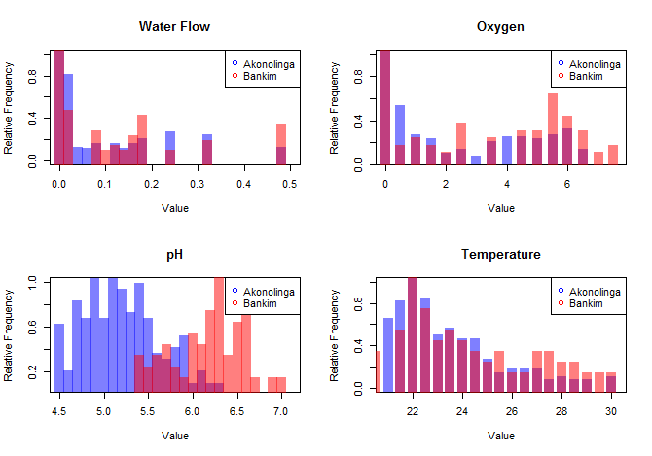
2
Why the two regions are so different?
Optimal pH for MU [5.8-6.5]
Environmental drivers of MU

Slide 30
2
Our theory
Scenario 1: Favourable physico-chemical conditions
Free living stages
&
Environmental transmission to aquatic organisms
Water flow
O2
pH (optimal)
Environmental drivers of MU

Slide 31

2
3
Our theory
Scenario 2: Adverse physico-chemical conditions
Mostly intra-host
&
Trophic transmission
Environmental drivers of MU

Slide 32
What type of modeling is necessary to answer my question?
Disease prevalence
M. ulcerans dynamics
Buruli ulcer
in humans
1
Environmental factors
MATHEMATICAL MODELING TO UNDERSTAND BU TRANSMISSION

Slide 33
3
Introduction
2 possible routes of transmission to humans
Transmission of MU to humans

Slide 34
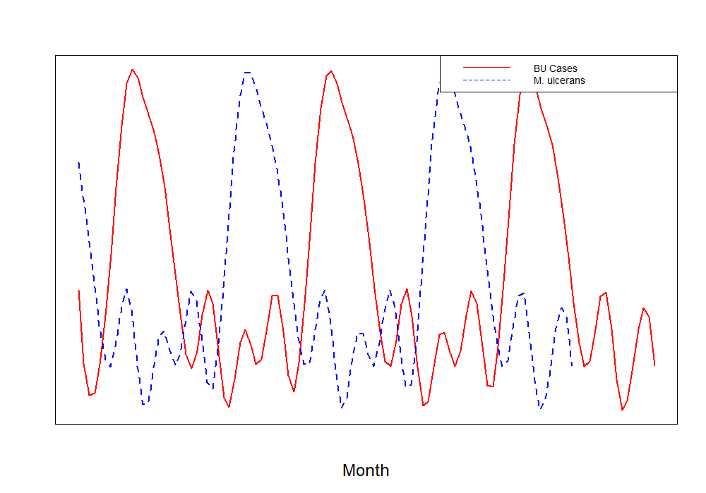
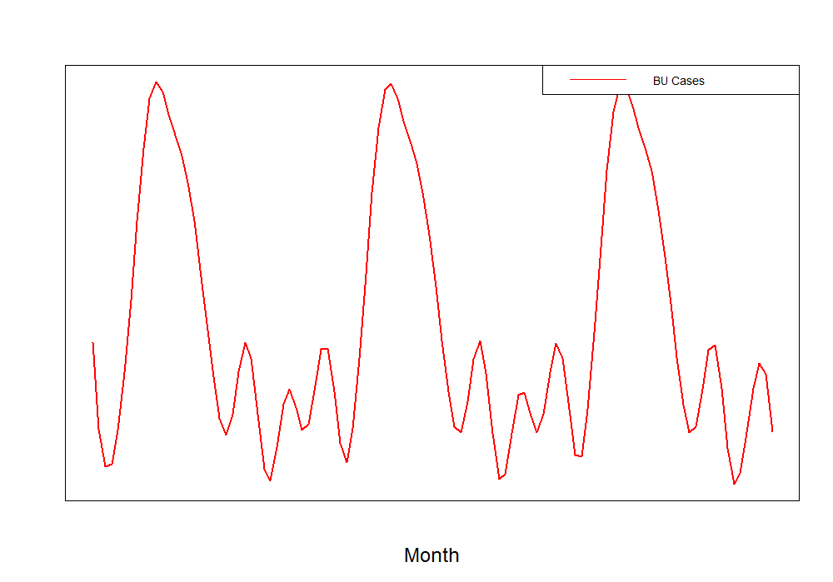
3
Introduction
Dynamic model
Transmission of MU to humans

Slide 35
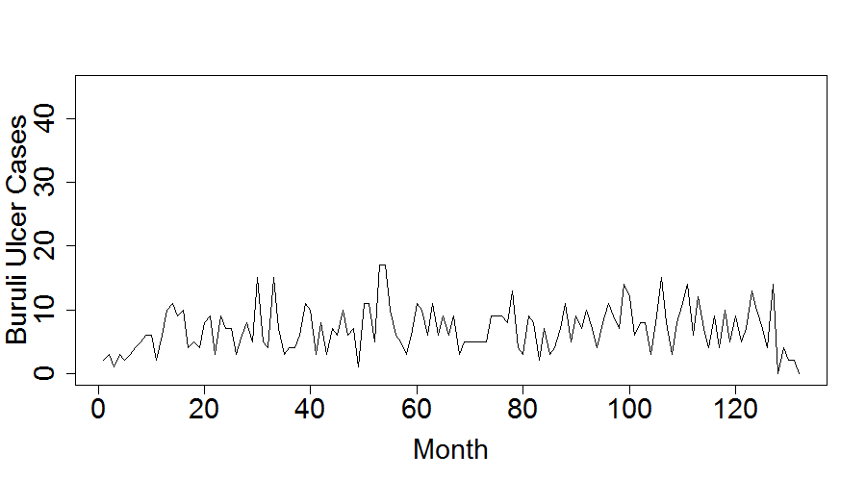
3
Temporal data
10 year database
BU cases diagnosed at Akonolinga Hospital
Transmission of MU to humans

Slide 36
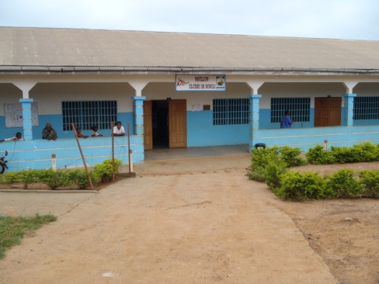
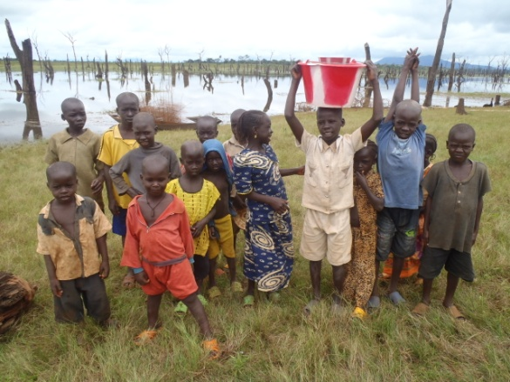
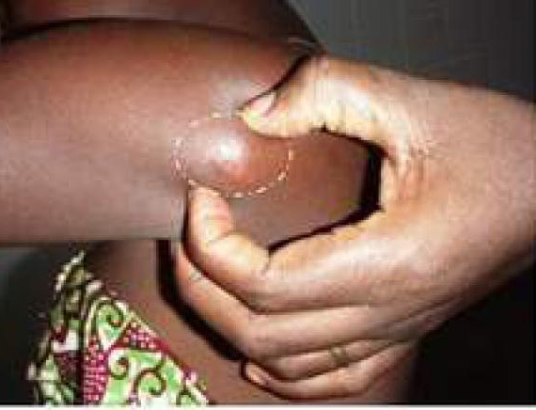
3
Mathematical model framework
MU in the environment
MU in waterbugs
βCH
βVH
ρ
S
E
δ
I
ε
T
Transmission of MU to humans

Slide 37
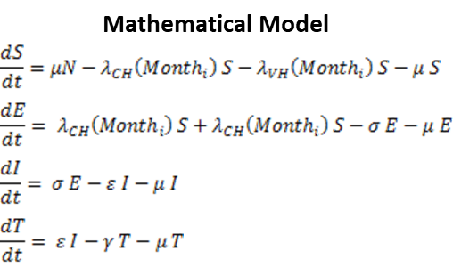
3
Mathematical model framework
MU in the environment
MU in waterbugs
βCH
βVH
ρ
S
E
δ
I
ε
T
Transmission of MU to humans

Slide 38
3
Mathematical model framework
MU in the environment
MU in waterbugs
βCH
βVH
ρ
S
E
δ
I
ε
T
Model simulations to account for:
A range of initial parameters
Uncertainties in rates of incubation (δ) and seeking treatment (ε)
Different proxies of waterbug tranmsission and environmental transmission
Linear risks or thresholds in the relationship MU-BU
Comparison of model fit using AIC and selection of best performing (2 AIC)
Transmission of MU to humans

Slide 39
3
Results for Buruli ulcer temporal dynamics
Best temporal fit
Environmental transmission >>>> water bug transmission
MU environmental concentration as linear predictor of BU cases
Transmission of MU to humans

Slide 40
AT THIS STAGE WE ARE ALMOST DONE…

Slide 41
vi
Manuscript writing and submission
1
1
1
What are the main results that provide the answer to my question?
1 to 3 graphs
1 to 3 tables
What is the journal that best fits my study?
Scope, audience, impact factor, math focus
How do I present my manuscript?
Introduction: set the stage to your question
Methodology: describe explicitly all steps for replicability
Results: clear and concise
Discussion: explain how your study improves previous knowledge
Conclusions

Slide 42

MODELING IN PRACTIVE: THE LIFE CYCLE OF A MODELING PROJECT, FROM CONCEPTION TO PUBLICATION - The example of Buruli ulcer in Cameroon -
Andrés Garchitorena
Researcher, Institut de Recherche pour le Développement
Associate Scientific Director, PIVOT Madagascar
E²M² Workshop
Ranomafana, January 2020

